Slide 1


Threat Hunting with Splunk
-by Vinay Gujar & Ronak Bhatt

Slide 2
Outline
Threat Hunting
ATT&CK Framework
Splunk

Slide 3
Threat Hunting
Threat hunting is, quite simply, the pursuit of abnormal activity on servers and endpoints that may be signs of compromise, intrusion, or exfiltration of data.
With threat hunting, you use humans to go “find stuff” versus waiting for technology to alert you.
We look for anomalies — things that don’t usually happen.

Slide 4
What to look for?
Processes: Hunters are looking for processes with certain names, file paths, checksums, and network activity.
Binaries: Here hunters look for binaries with certain checksums, file names, paths, metadata, specific registry modifications, and many other characteristics.
Network activity: This threat attribute includes network activity to specific domain names and IP addresses.
Configuration modifications: Hunters can look for specific configuration additions and modifications.

Slide 5
MITRE ATT&CK Framework
ATT&CK provides the most comprehensive model of modern attacker behavior.
Tactics represent the “why” of an ATT&CK technique. The tactic is the adversary’s tactical objective for performing an action.
Techniques represent “how” an adversary achieves a tactical objective by performing an action.
The framework binds the “why “ and “how” of the threats to create a matrix .

Slide 6
How ATT&CK framework works?
Each tactic has a UID which can be traced back in the matrix
Threat hunting is performed using this matrix of framework
ATT&CK specifics of what to hunt for in different threat conditions
Initial access
Execution
Persistence
Privilege escalation
Defense evasion
Credential access etc.

Slide 7
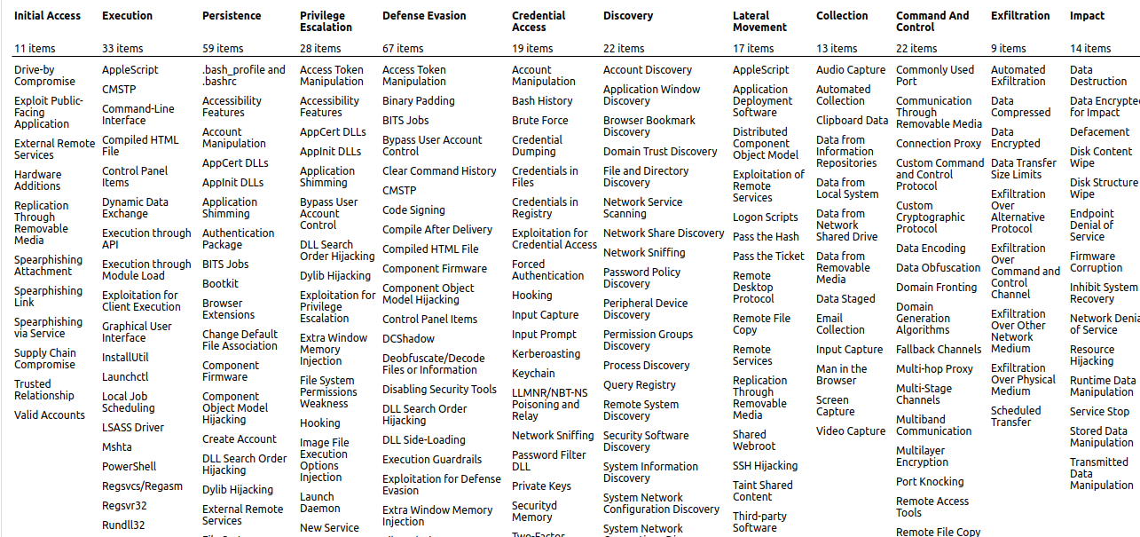
ATT&CK tactics and techniques

Slide 8
Analyzes the aggregate of logs from a big service cluster
Finds real-time logs and with faster speed
Generates report and alerts for the desired search
Provides enhanced GUI and real-time visibility in dashboard in various formats
Provides quick results by reducing the time to troubleshoot and resolve issues
Works like a monitoring, reporting and analysis tool and provides insights
Splunk

Slide 9
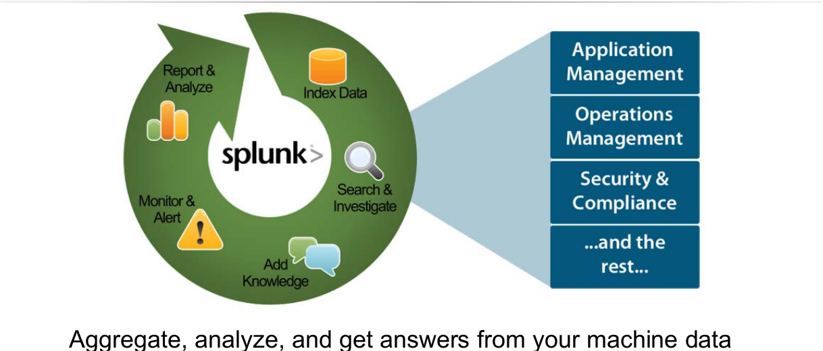
What is Splunk?

Slide 10
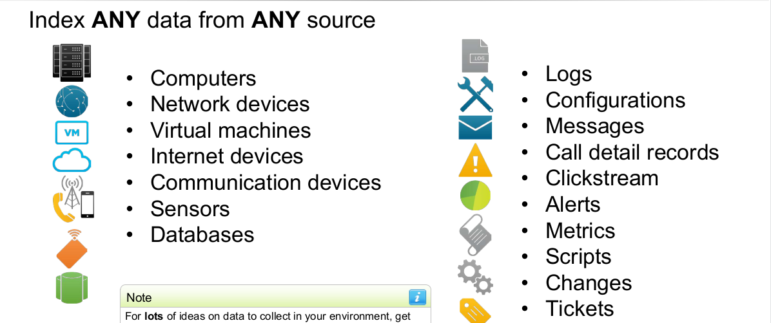
What Splunk can collect?

Slide 11
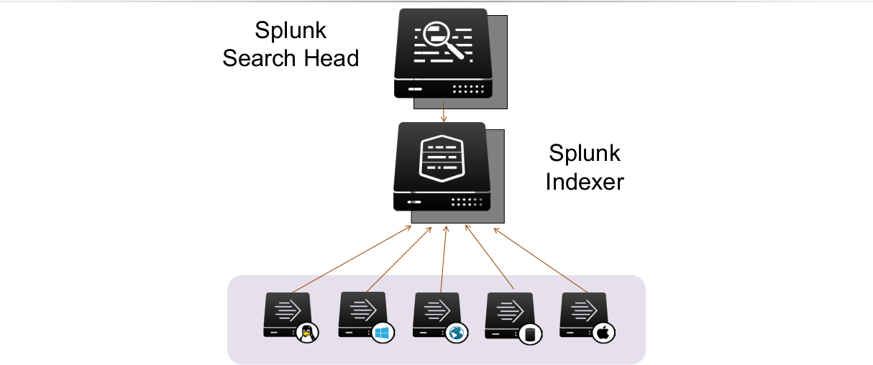
How Splunk works?

Slide 12
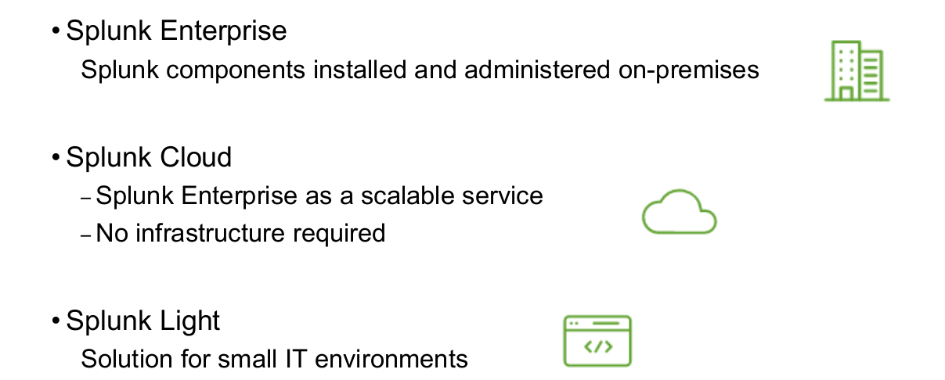
How Is Splunk deployed?

Slide 13
What are Splunk Apps?
Designed to address a wide variety of use cases and to extend the power of Splunk
Collections of files containing data inputs, UI elements, and/or knowledge objects
Allows multiple workspaces for different use cases/user roles to co-exist on a single Splunk instance
1000+ ready-made apps available on Splunkbase (splunkbase.com) or admins can build their own

Slide 14
What are Splunk Enhanced Solutions?
• Splunk IT Service Intelligence (ITSI)
– Next generation monitoring and analytics solution for IT Ops
– Uses machine learning and event analytics to simplify operations and prioritize problem resolution
• Splunk Enterprise Security (ES)
– Comprehensive Security Information and Event Management (SIEM) solution
– Quickly detect and respond to internal and external attacks
• Splunk User Behavior Analytics (UBA)
– Finds known, unknown, and hidden threats by analyzing user behavior and flagging unusual activity

Slide 15
Live Demo 🔛

